Slide 1


Know the Carbon Pollution Toolkit
Which carbon pricing approaches deliver deep, sustained cuts in emissions?
Brad Warren, Julia Sanders (GOH) & Lisa McCrummen (WBCA)

Slide 2
GOH and Working Group
Global Ocean Health program of NFCC: focused on ocean acidification, climate change, and other marine consequences of the global carbon crisis.
Organized Working Group on Seafood and Energy because industry leaders asked us for guidance on how to tackle carbon pollution.

Slide 3
Working Group
Ocean highly sensitive to CO2 emissions, so we favor strong, fast, sustained reduction to protect marine resources and fisheries.
We work with vulnerable people, businesses and communities that rely heavily on transportation fuels, so we favor policies that can help them become part of the solution (not just raising their fuel costs).
In WA, we chose to work with WBCA and Alliance for Jobs and Clean Energy because their plan has potential to deliver well against those goals.

Slide 4

Do some carbon emissions regimes outperform others? Yes
Cause/effect often elusive
—Many concurrent forces at play
Emissions trends still tell a story.
Ocean will only respond to results: deep, sustained emissions reduction.

Slide 5
Premise: history now deep enough to see how pricing systems perform
~40 carbon nations
20+ cities, states and regions
Some date as far back as 1990
Our aim: find time series and see what they tell us.
Does their track record suggest they can achieve ambitious emissions reductions targets?

Slide 6
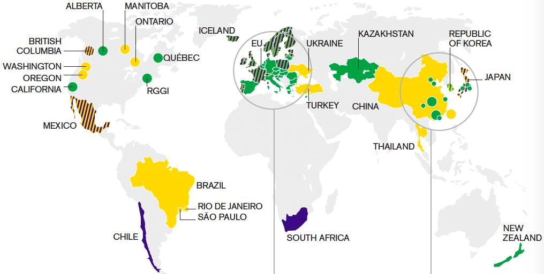
Can they deliver?
IPCC AR4 target mitigation scenarios equate to 80-95% cut in C emissions by 2050 in industrialized countries (from 1990 levels).

Slide 7
We looked at 18 systems old enough to tell (2010 or before)
BC tax 2008
Costa Rica tax 1997
Denmark ETS/tax 1992
Iceland ETS/tax 2010
Ireland tax/ETS 2010
Norway tax/ETS ‘91/08
Sweden tax 1991
Switzerland ETS/tax ‘08
Finland ETS/tax 1990
Poland ETS/tax ’90/05
Latvia ETS/tax ’95/’05
Slovenia ETS/tax 1996
Estonia ETS/tax 2000
EU ETS 2005
Alberta tax 2007
RGGI ETS 2009
Tokyo ETS 2010
Boulder, CO tax 2007
Two North American “stars”: different approaches, both well documented

Slide 8
British Columbia
Carbon tax: started 2008.
Price: began at $10/t, rose to $30 by 2012
Use of funds: Revenue neutral. Funds reduce income & corporate tax; low-income tax credit; credit for northern and rural homeowners.
Concurrent regs: Mark Jaccard, SFU energy econ professor, recknos regs did more to lower emissions, were easier to put in place. (One reg stopped new gas & coal plants)

Slide 9
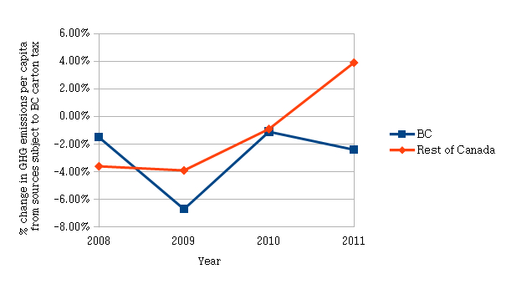
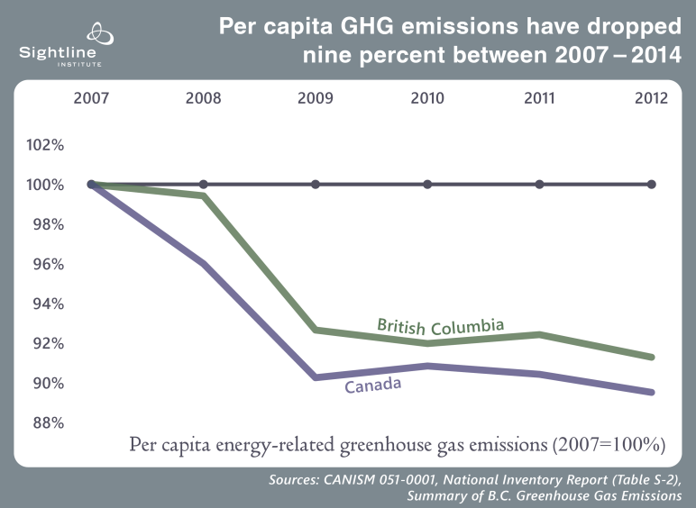
BC emissions time series – two stories
2+% drop by 2013…
…or 9% by 2014
SOURCE: Elgie, S. & McClay, J. BC’s carbon tax
shift after five years: Results. An
environmental (and economic) success
story. Sustainable Prosperity 2013
Performance against goal:
BC not on track to reach target of
33% reduction by 2020

Slide 10
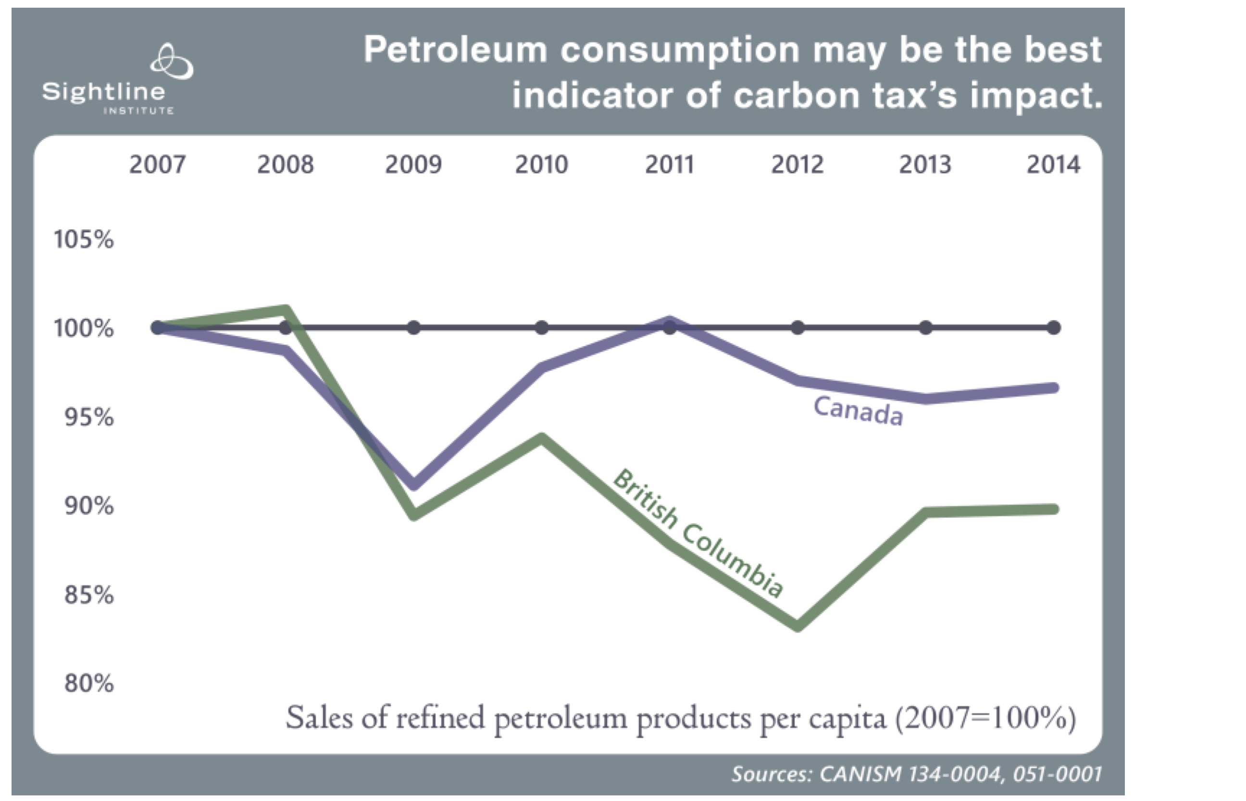
BC fuel consumption
Consumption climbs from 2012, when BC carbon
tax reached its legal limit:
C$30/t

Slide 11
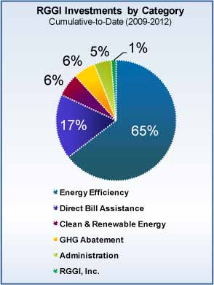
Reduction via reinvestment: RGGI
DESIGN
9 states from Maine to Maryland (less NJ)
Cap & trade for utility emissions
Pooled funds provide capital to invest in energy efficiency and renewables—driving down costs
Price: $6/t in 2015 (up from $2)
RESULTS
35% reduction in carbon emissions since 2009
More than 23,000 jobs created
Lower energy bills due to investments in efficiency
Sources: Acadia Center, RGGI

Slide 12

RGGI Performance - Emissions
Preview: Jordan Stutt re RGGI
Reductions: tracking to 50% below 2005 by 2020
Basis for setting initial cap
Notes:
Health Co-benefits from SO2, Nox reductions: >$10B 2009-2013, >$1.5 2014-2020
Tracking toward 50%: from ICAPcarbonaction.com: https://icapcarbonaction.com/images/StatusReport2015/ICAP_Report_2015_02_10_online_version.pdf

Slide 13
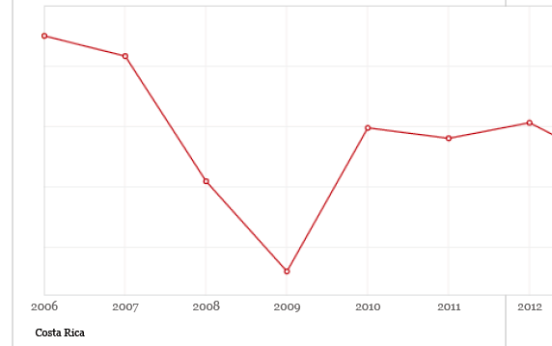
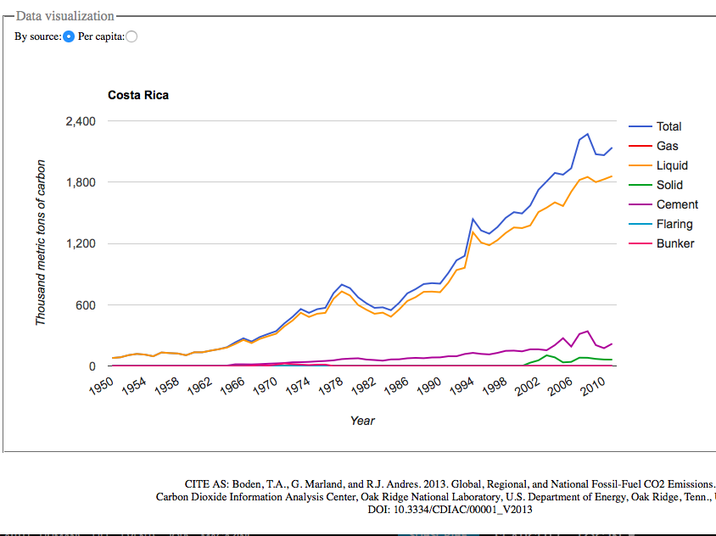
Costa Rica
Started 1997
Tax = 3.5% of fossil fuel price
Drop coincides with
Recession’s trough in GDP
Emissions grew 57%
during 1997-2011
Start 1997
SOURCES: World Bank,
CDIAC

Slide 14
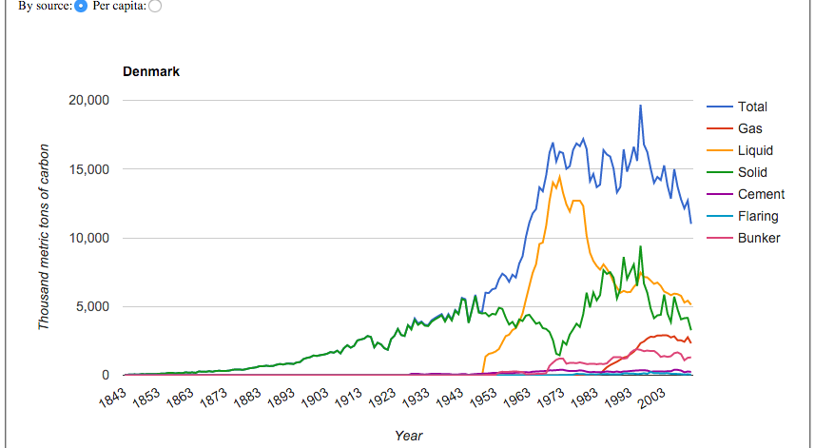
Denmark
Target: 40% below 1990 by 2020 (to reach 80-95% cut by 2050)
Trajectory: will exceed by 4m t in 2020
Carbon tax: $31/t (2014)
Tax covers all fossil fuels, but partial exemption for sectors in ETS
SOURCES: CDIAC, Danish Climate Plan 2013; World Bank;

Slide 15
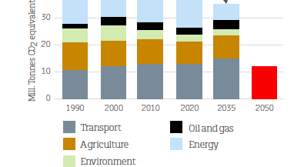
Denmark emissions
Transport emissions rising despite
high fuel prices and carbon pricing
NOTE: Denmark
avg petrol price
Aug 2013: $6.92gal
SOURCES: Danish Climate Policy Plan, Aug 2013; Auto Association Developments Ltd

Slide 16
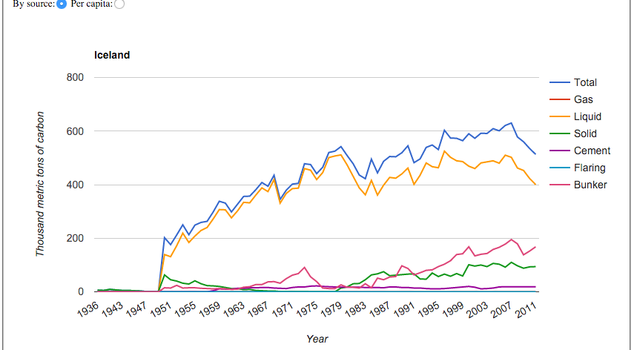
Iceland
Hybrid: Carbon tax and European ETS
Tax started 2010, covers half of GHG emissions.
Renewables: 85% of primary energy supply.
Tax rate: $10/t in 2014.
SOURCES: CDIAC; OECD; World Bank State and Trends of Carbon Pricing 2014

Slide 17
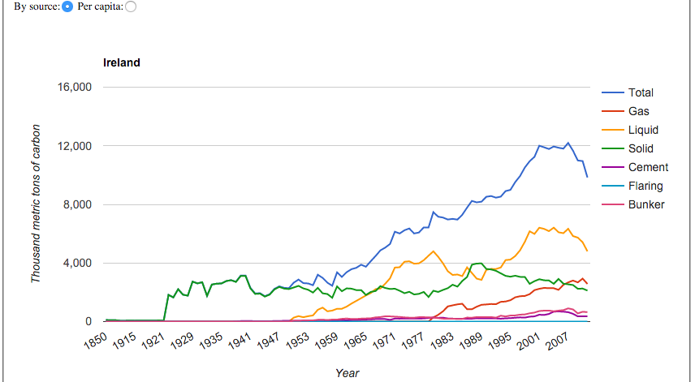
Ireland —emissions time series
Hybrid: Carbon tax: Euro15/t tax starting 2010 and also ETS starting 2005
Coverage: non-ETS sectors (transport, heating, small business process emissions)
SOURCE: CDIAC

Slide 18
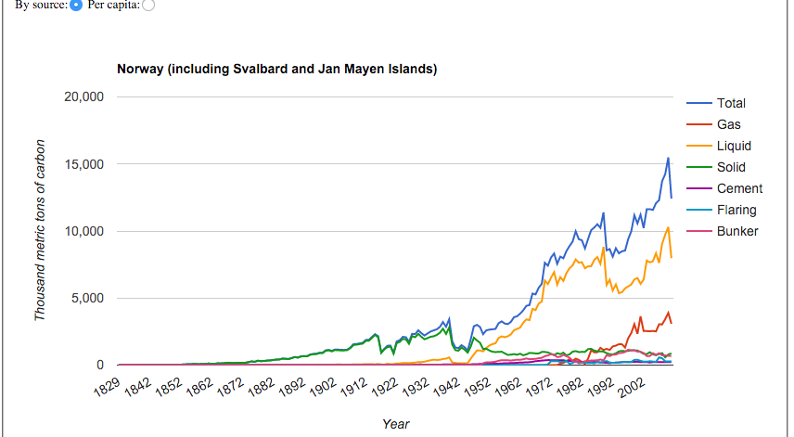
Norway
Hybrid: tax started 1991, joined Euro ETS voluntarily 2008
Coverage: Tax 62% of CO2 emissions
—Tax $51/t on gasoline, avg $21/all fuels
—Emissions ~doubled since tax started
—But big drop in last few years

Slide 19
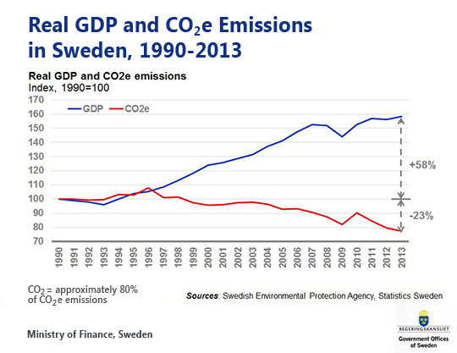
Sweden
Target: 2050: Fossil Free, Zero net ghg
Trajectory: 13% reduction of ghg
Carbon tax: $168/t (2014) Highest in the world
Tax covers: Coal, oil, natural gas, petrol and aviation fuel domestic travel
Biofuel exempt.

Slide 20
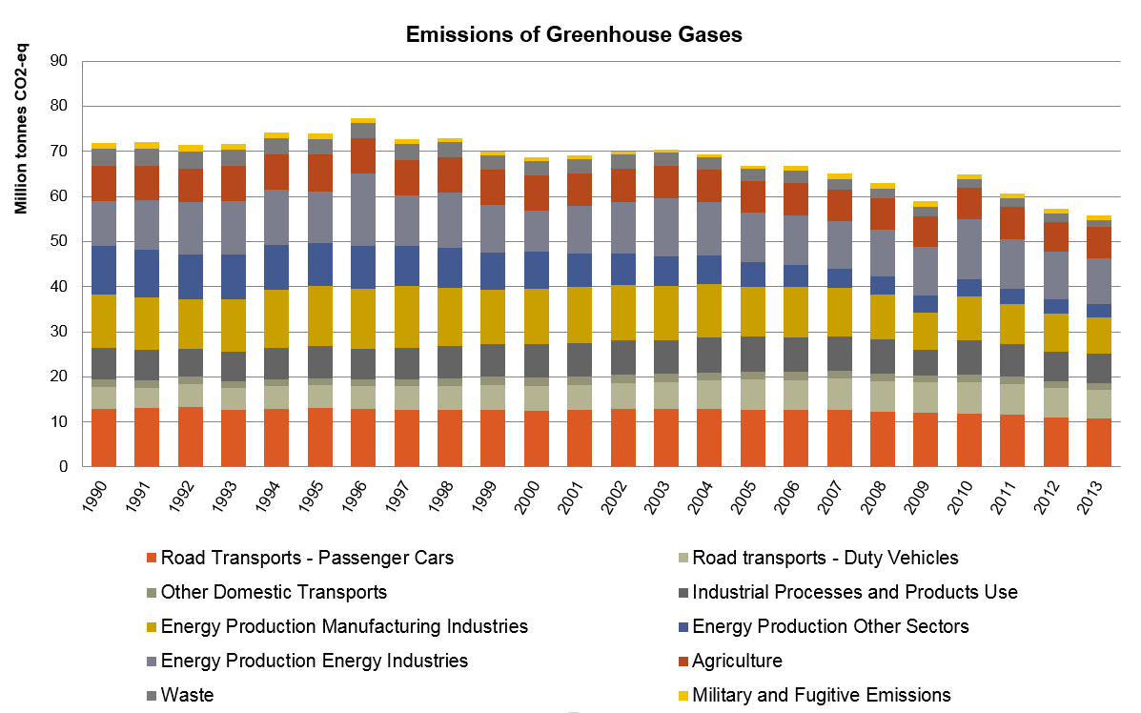
Sweden Emissions
2020: Policy vision beyond tax
20% energy intensity reduction
Min 50% renewable energy in gross final consumption;
10% in transport
GHG emissions reductions 40%
Nuclear/hydro continue
Data source: Swedish Environmental Protection Agency, 2014

Slide 21
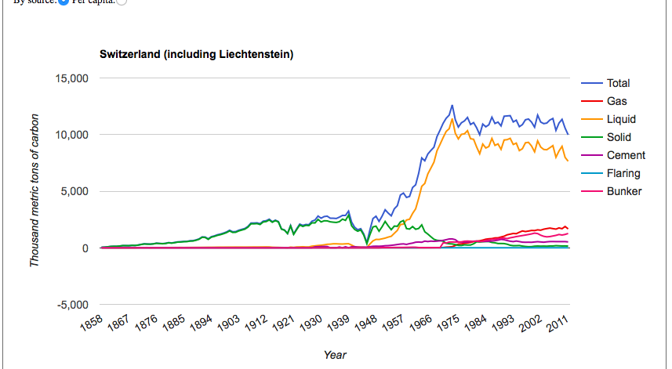
Switzerland
Hybrid: Tax/ETS, started 2008 (ETS covers 10%: electricity, buildings)
Effective price: 108 Euro/t (carbon tax reported as$52-62/t)
SOURCES: CDIAC, World Bank, OECD

Slide 22
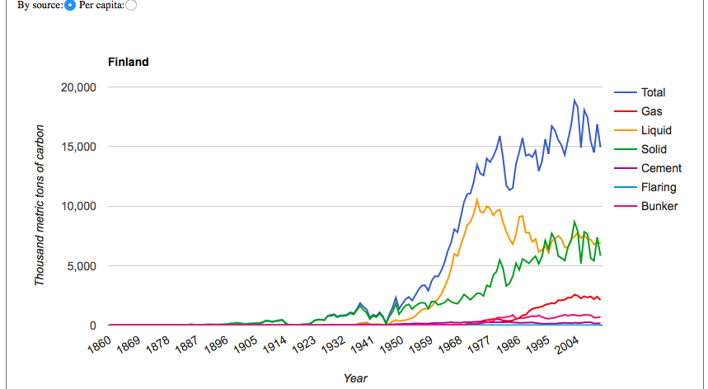
Finland - Two time series, CDIAC vs national
Hybrid: tax (1990), ETS (2005)
Tax rate: Eur35/t in 2014
Coverage: first heat & electric production, then transport & heating fuels
CDIAC

Slide 23
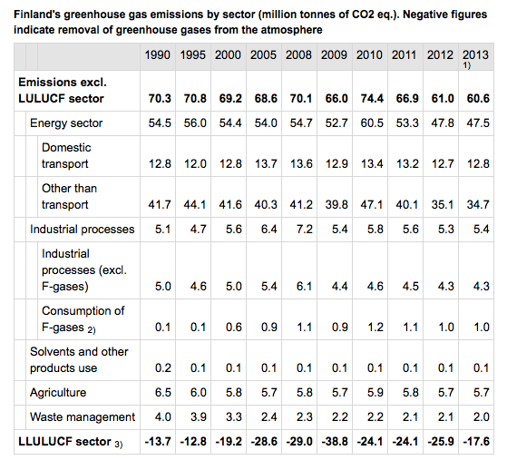
Finland – national gov’t time series
-13.8% since 1990

Slide 24
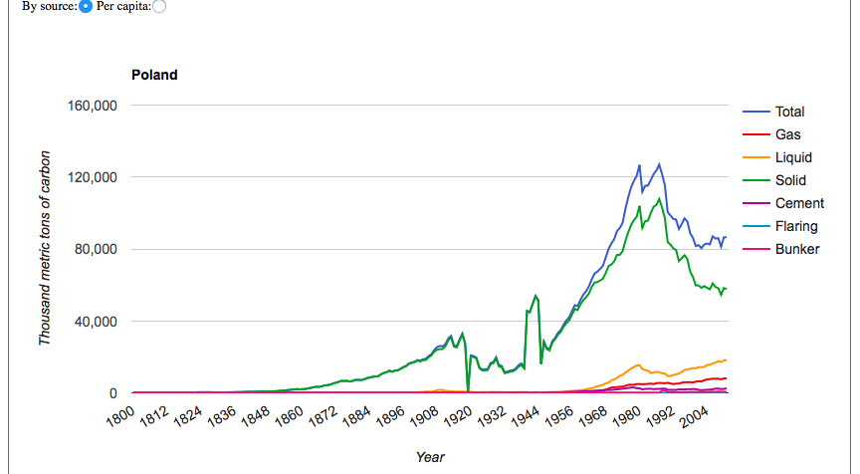
Poland
Hybrid: Tax (1990) and ETS (2005)
Tax rate: < $1
Emissions 32% since 1995
Role of tax vs other factors?
SOURCES: CDIAC, World Bank, EEA GHG inventory, EEA

Slide 25
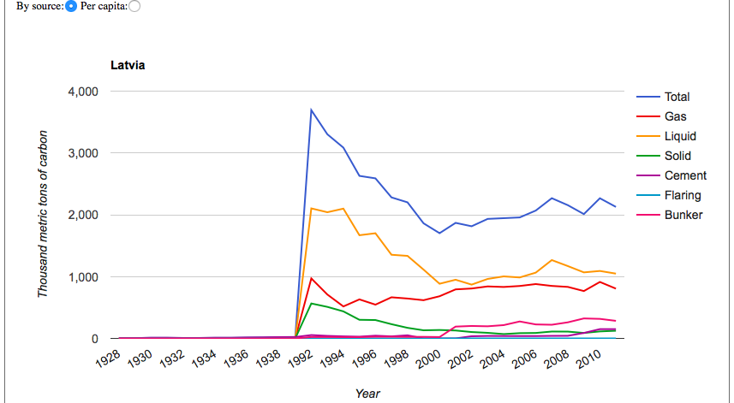
Latvia
Hybrid: tax (1995) and ETS
Tax rate: $4
SOURCES: CDIAC, World Bank State & Trends 2015

Slide 26
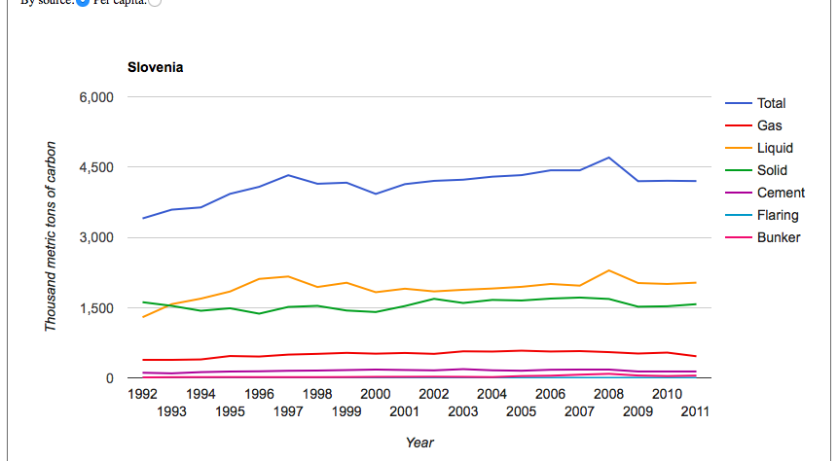
Slovenia
Hybrid: tax (1996-7) & ETS
Tax rate: started Eur4.2/t, Eur12.5/t in 1998, now $19/t
Covered: all fuels, but coal for power was exempt until 2003; transport fuels 2011
Sources: CDIAC, FOES.DE 2012 report

Slide 27
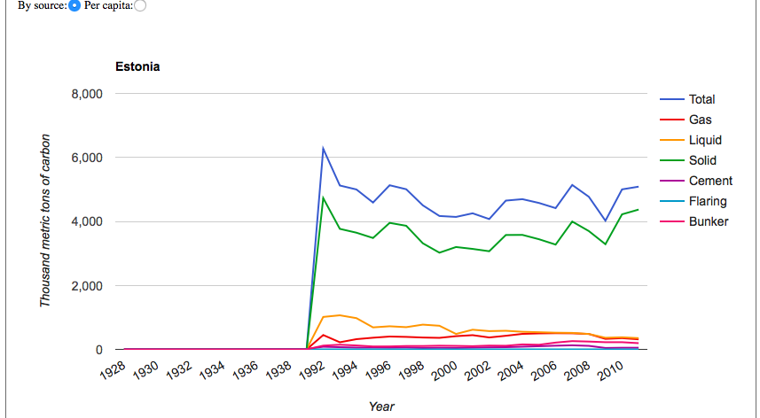
Estonia
Hybrid: Carbon tax (2000) and ETS
Tax rate: $2/t. Has increased several times
Use of funds: Increases in C tax )2005, 2006-2008) have reduced income tax,
expanded sales tax exemption.
—Emissions have increased
—Drop in 2006-2008: linked to
price increase?

Slide 28
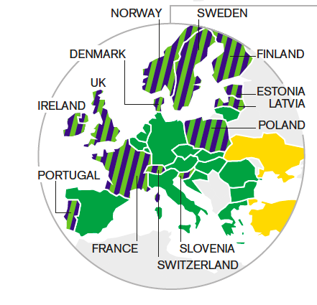
EU Emissions Trading System
Start: 2005
28 countries
Price: $9/t (2013) (but it tumbed in Apri13 to E2.60, lowest)
Cap: declines 1.74% annually since 2013
Covers: power stations, other fixed plants (41-45% of total emissions)
Cap target: 21% reduction from 2015 to 2020; 80-95% reduction from 1990 by 2050
Aviation has own cap: 5% below 2004-2006 during 2013-2020 period.
Historical error: overallocated allowances, crushed price initially, but it has recovered
SOURCES: EU, WRI

Slide 29
EU 28 carbon emissions
Does EU ETS work?
It shouldn’t. In 2011, 77% of ETS installations held surplus allowances. Price collapsed to 2.60 Euro£s in 2013.
Still, some analysts say it’s working: 40% of the 3% fall from 2007 to 2008 attributed to ETS (only 30% attributed to fall in industrial output due to Recession) (NCF09)
What do the data say?
SOURCES: ISE.AC.UK/Grantham Institute, New Carbon Finance 2009

Slide 30
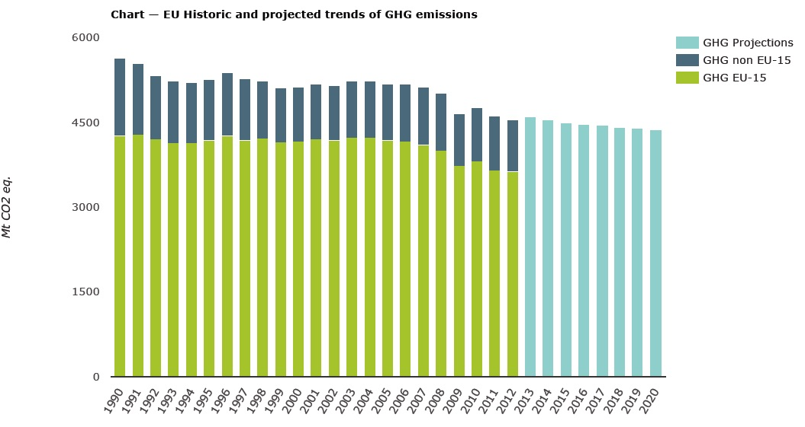
EU Emissions
1990-2012: 19.2% decline in EU28 emissions
Start
Trend
Predated ETS
Recession + ETS
Other drivers?
Energy intensity
dropped 1.7%/yr in EU28 1990-2013
Complementary policies
Fuel switching
Recession
SOURCE: European Environment Agency,
http://www.eea.europa.eu/data-and-maps/data/data-viewers/greenhouse-gases-viewer

Slide 31
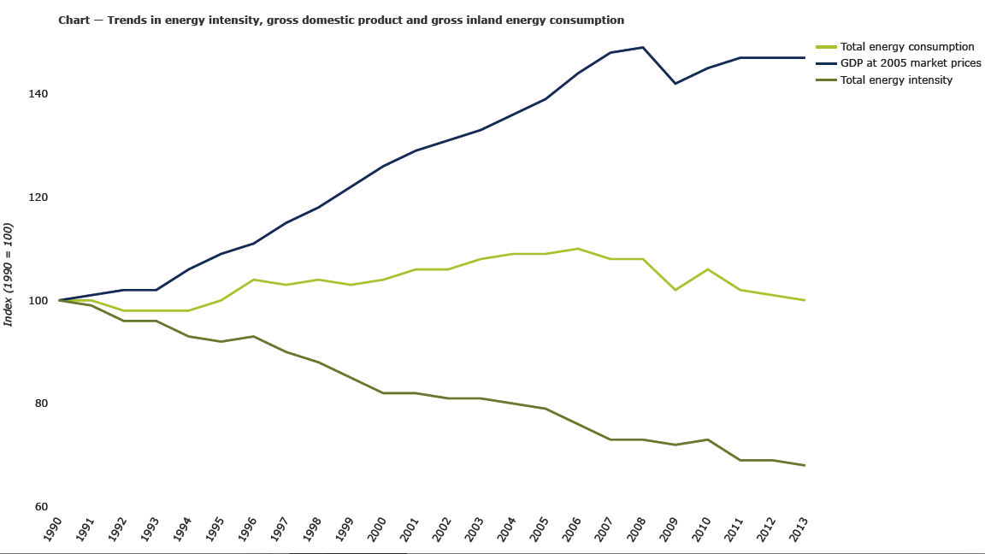
EU Energy intensity
Efficiency is driving
most EU reductions

Slide 32
Is Europe moving fast enough?
Just barely.
IPCC AR4 suggested 80-95% reduction target for developed countries by 2050. That requires 25-40% cut by 2020. At 19% today, EU is tracking toward low end.
To reach 80% by 2050, EU would need to cut 47% by 2030 (would require faster reduction)
SOURCE: Knopf & Geden, A warning from the IPCC: the EU 203s climate target
cannot be based on science alone, Energy Post, June 26, 2014

Slide 33
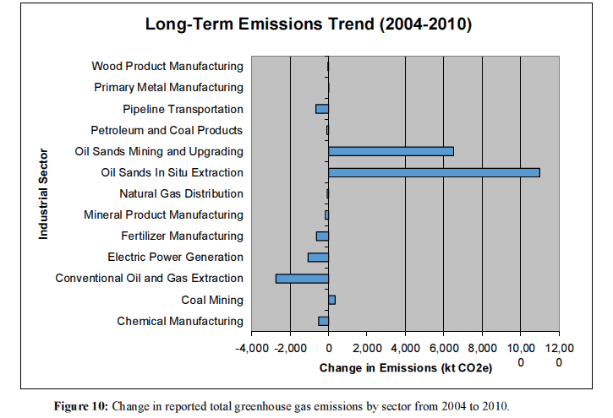
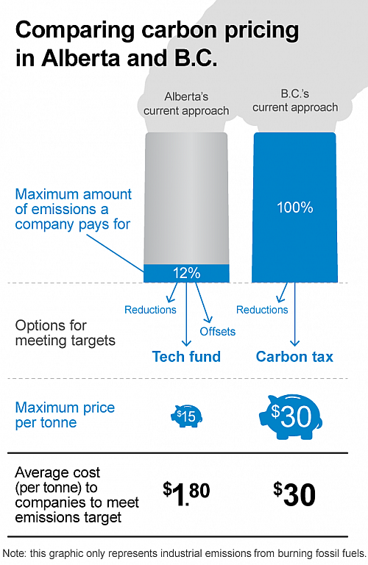
Alberta
Target: TBD, ‘plan’ being overhauled; focused on reducing big polluters ghg.
Trajectory: Ghg rising. 30 MT higher in 2013 than in 1990. While most of the sites are gas plants, a great majority of emissions come from seven coal power plants and five oilsands mines/upgraders.
Carbon tax: Misleading $15/Canadian, rise to $20 before a further hike to $30 in 2017.
Source: Pembina

Slide 34
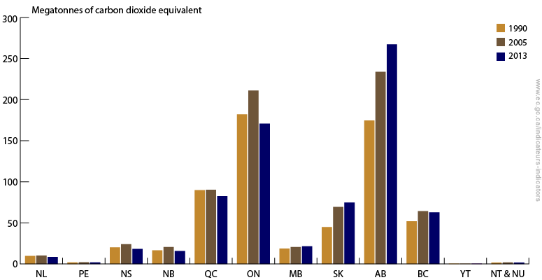
Alberta Emissions
If Alberta were a country, it would have per capita emissions 3x the U.S.
Without overhaul, emissions are projected to rise another 20 per cent by 2020.
Data source: : Environment Canada (2015)

Slide 35
Boulder, CO
Revenue Positive Carbon Tax
In 2007, Boulder voters approved a tax on electrical usage across all segments by a vote of 60.5%. Then 82% voted in 2012 to extend the tax another 5 years, and in 2015 77.5% voted to extend it through 2023.
Pricing: initially $.0022 per Kwh, businesses paid $.0004, and industrial $.0002. In 2009 rates were raised to $.0049 pr Kwh for residential, $.0009 for commercial, and $.0003 for industrial, where they will remain through 2023.
Annually this equates to about $21 per residential customer, $94 per commercial, and $9,600 per industrial account, or about $12-13/ton
Emissions have remained steady with a slight increase since 2007
Goal 80% reduction over 2005 by the year 2050

Slide 36
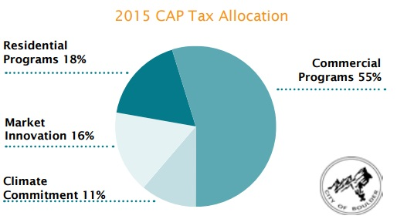
Boulder Revenue Reinvestment
Revenue-positive carbon tax
~$1.8mil is generated annually
Only ~40% goes directly to energy saving programs, the rest goes to administrative and monitoring costs

Slide 37
Tokyo, Japan
Cap-and Trade Market
Emissions Trading Scheme launched in 2010
Goal: 25% below 2000 levels by 2020
To be required to participate, entities must consume 1500kl (~363,000gals) of crude oil equivalent annually.
From 2010-2014, required an 8% reduction from businesses, and a 6% reduction from industrial facilities. From 2014-2019, reductions increased to 17% and 15%, respectively.
Facilities participating in the market can purchase credits from other businesses, including from other facilities’ excess, from renewable energy credits (RECs), and from certain allowable facilities outside Tokyo

Slide 38
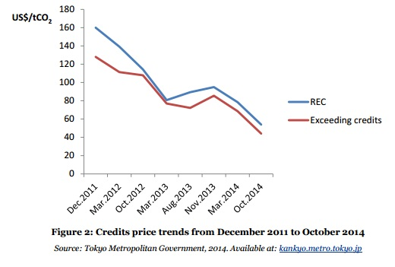
Tokyo Carbon Pricing
Cost per ton has been high but declining. In October 2014, prices for Renewable Energy Credits were about $45 per ton of carbon (from a high of ~$160/ton in 2011), and about $36 for excess credits (down from high of ~$130)

Slide 39
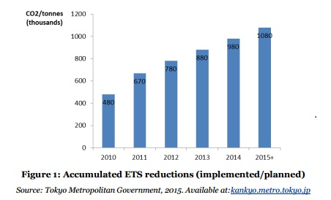
Tokyo Emissions Reductions
First compliance period ended December 2014 and achieved an emissions reduction of 23% compared to base year emissions during the four years
By February 2015, over 90% of covered facilities had surpassed their reduction targets for the first compliance period and 69% of facilities had already exceeded their second compliance period targets of 15-17% reductions.

Slide 40
Preliminary lessons
Some key factors in efficacy of pricing systems
Price: If politically limited, see use of funds
Scope:
Use of funds (See RGGI & BC)
Scale (see Boulder)
FOR ETS
Don’t overallocate (see EU)

Slide 41



Thanks
Brad@globaloceanhealth.org

